Slide 1

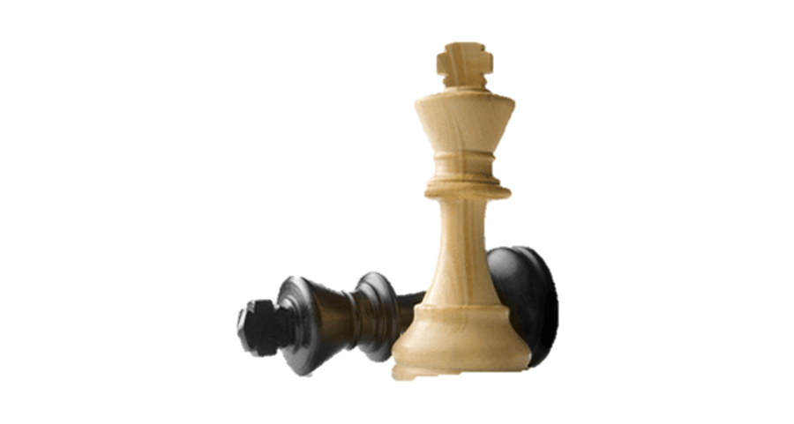
Exploratory Data Analysis
LiChess Games
AYAD SAUD AL HARBI

Slide 2
Objects:
01
03
02
05
03
Introduction
Conclusion
Analysis
Questions
Tools

Slide 3
Introduction

Slide 4
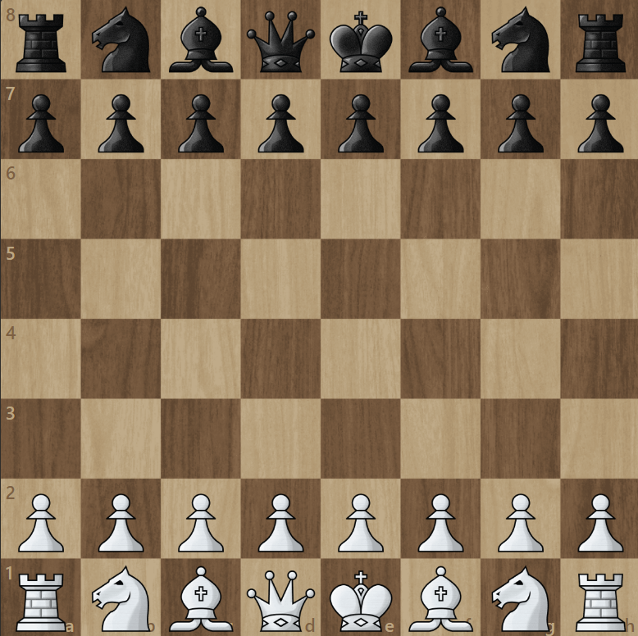
What is Chess?
Chess is a global game played by two players White and Black on a board of 8×8 squares. The game aims to trap your opponent's king (Checkmate), The game may end with a draw or a resign.
1 To 8
A To H

Slide 5
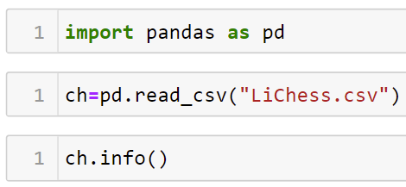
General Information:

Slide 6
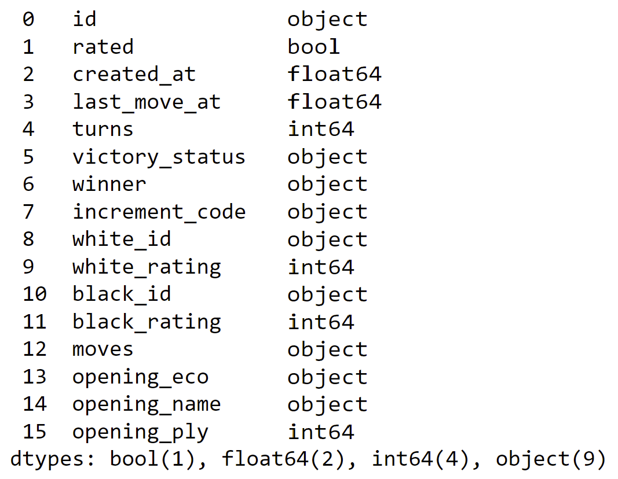
General Information:
Rows
16
Columns
20058

Slide 7
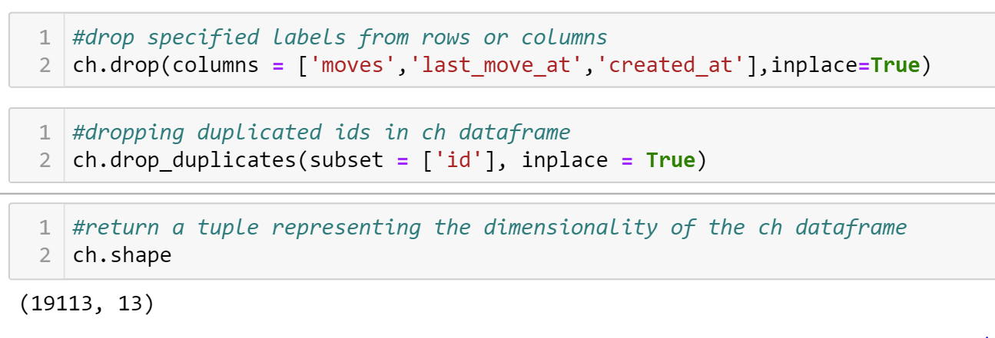

Slide 8
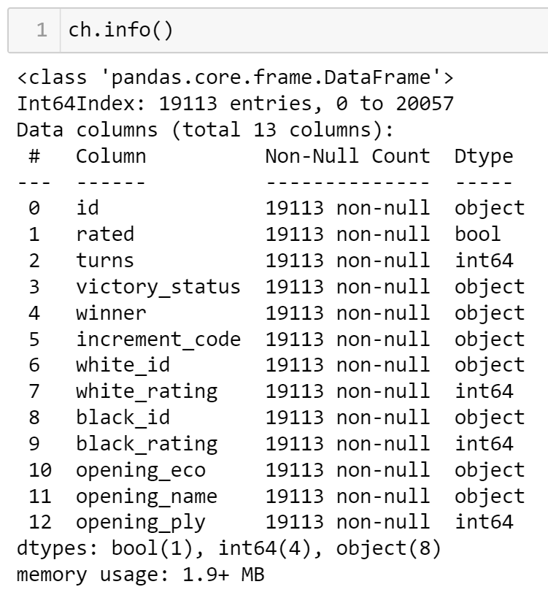

Slide 9
Questions

Slide 10
Questions:
What are the most popular Chess Openings?
How Most of the Chess matches concluded?
Which Color Side is more likely to win?
What is the distribution of rated players?

Slide 11
Analysis

Slide 12
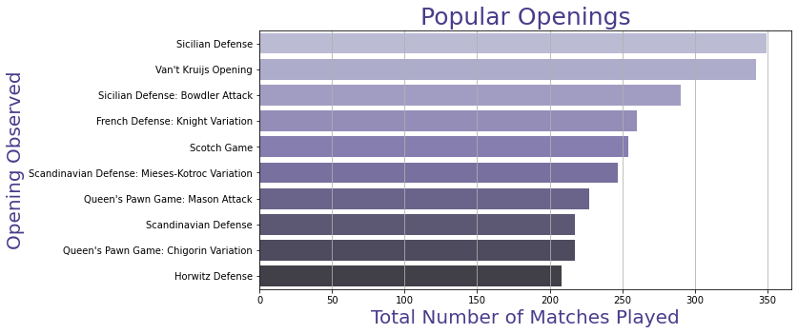
What are the most popular Chess Openings?

Slide 13
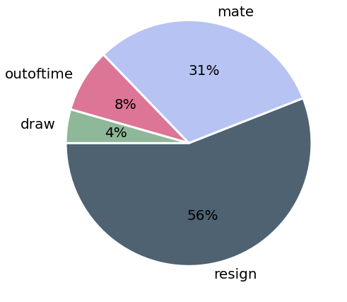
How Most of the Chess matches concluded?

Slide 14
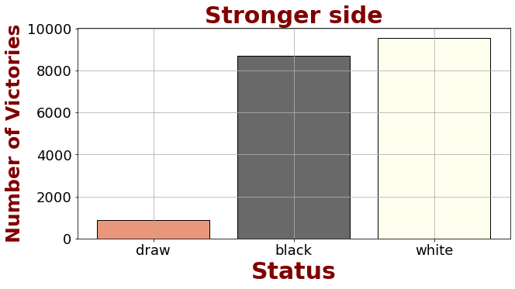
Which Color Side is more likely to win?

Slide 15
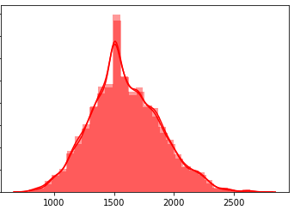
What is the distribution of rated players?

Slide 16
Conclusion

Slide 17
Conclusion:
Van't Krujis and Sicilian Defense are the most opening played.
Most of the games concluded when a player resigned.
White Side seems to more victorious in the game.
All rated matches were between likely equally rated players.

Slide 18
Tools

Slide 19
Tools:
PowerPoint
Python
Jupyter Nootbooks
Pandas
matplotlib
seaborn

